Slide 1
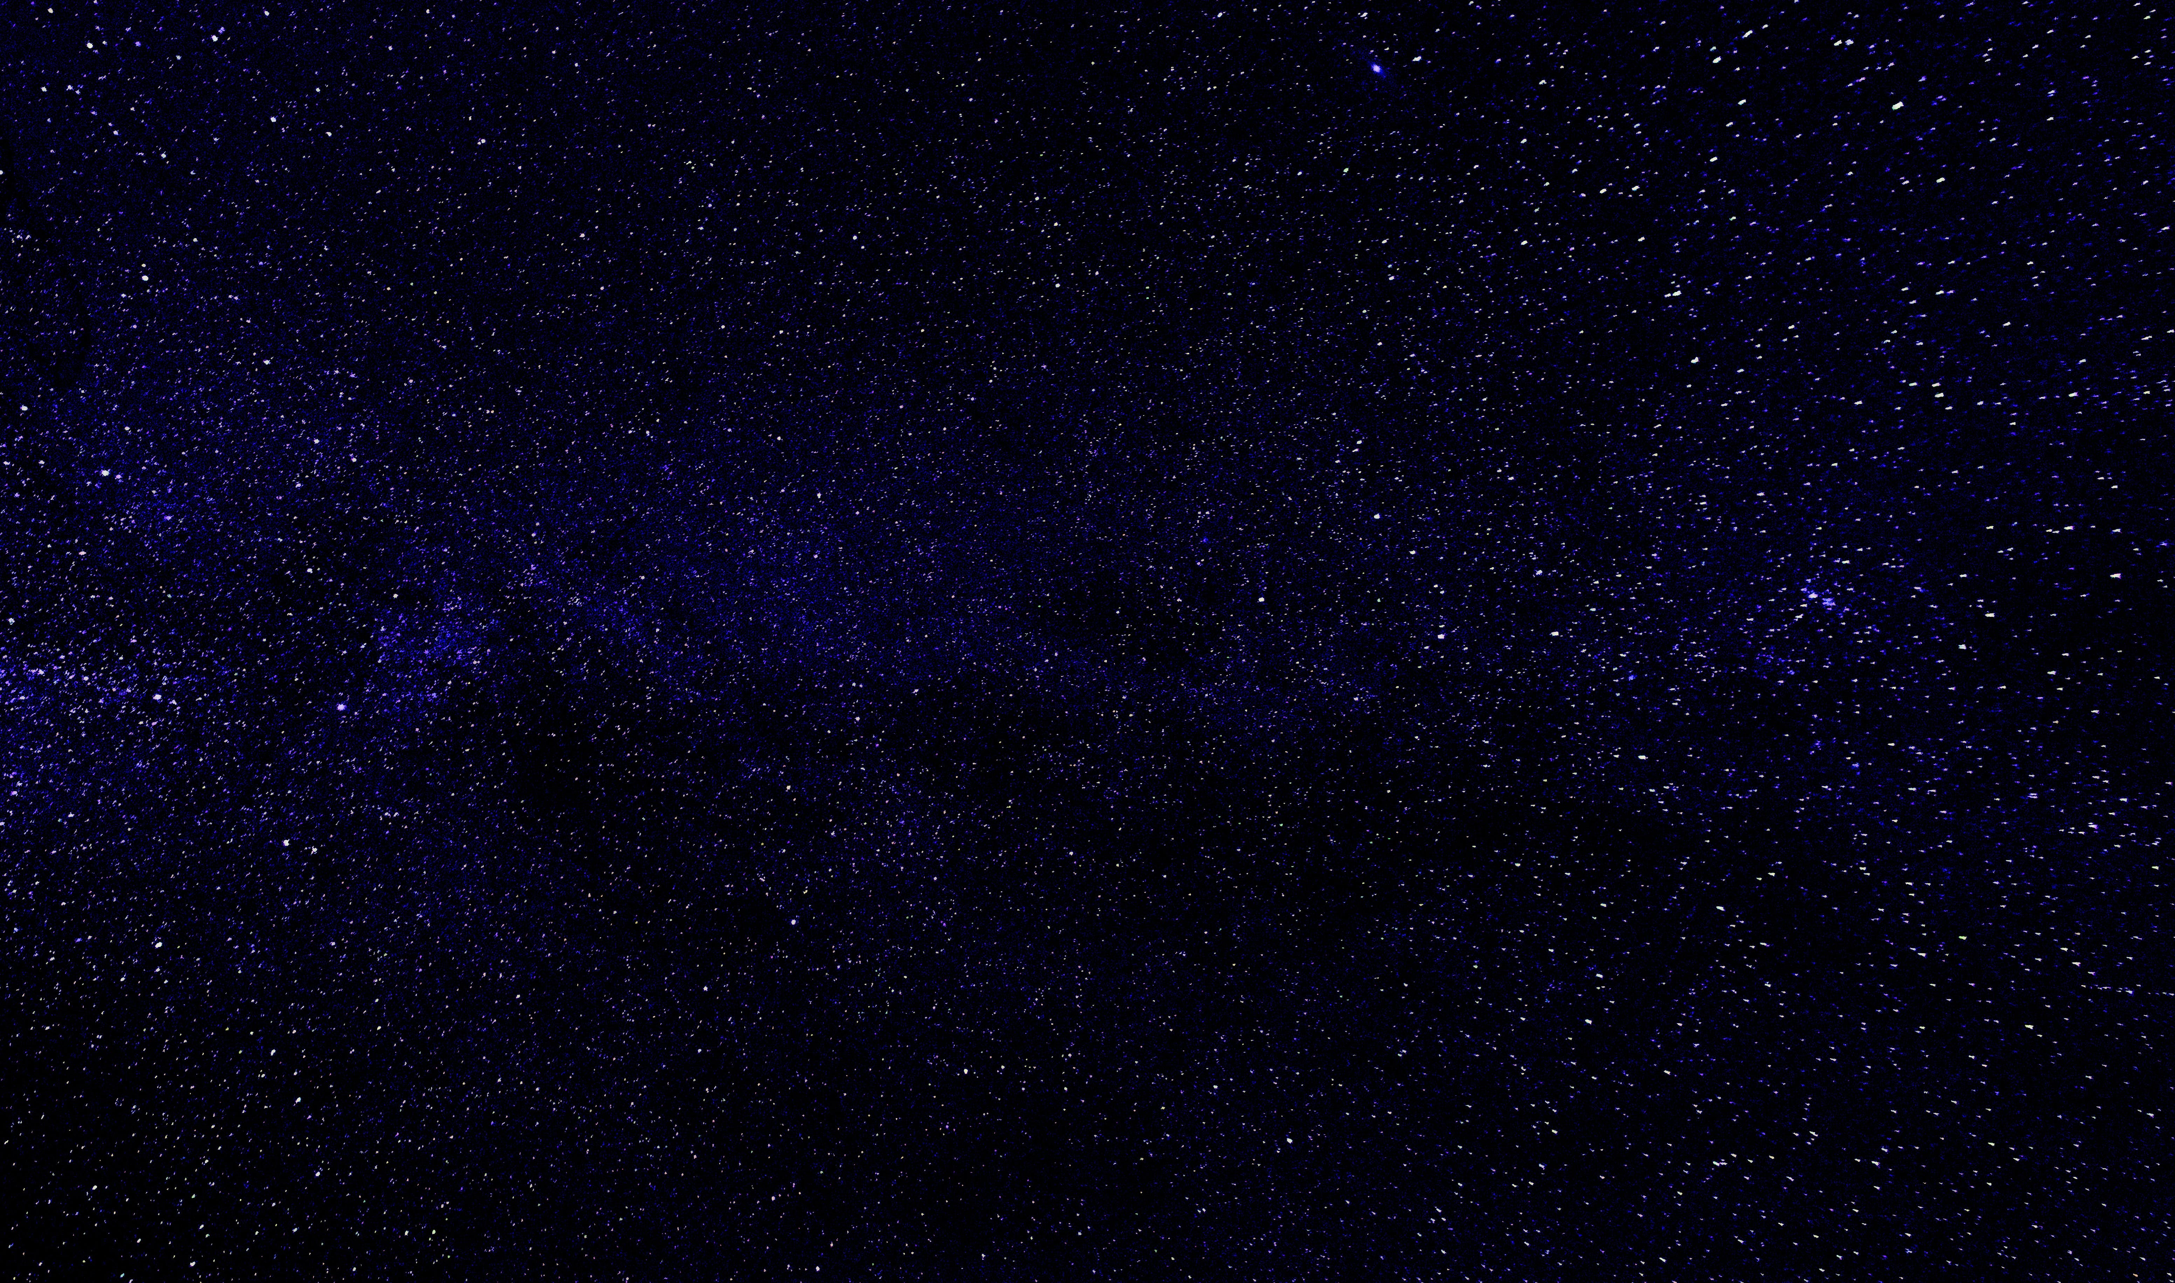
MBP
Modern Bright Planetologists

Slide 2
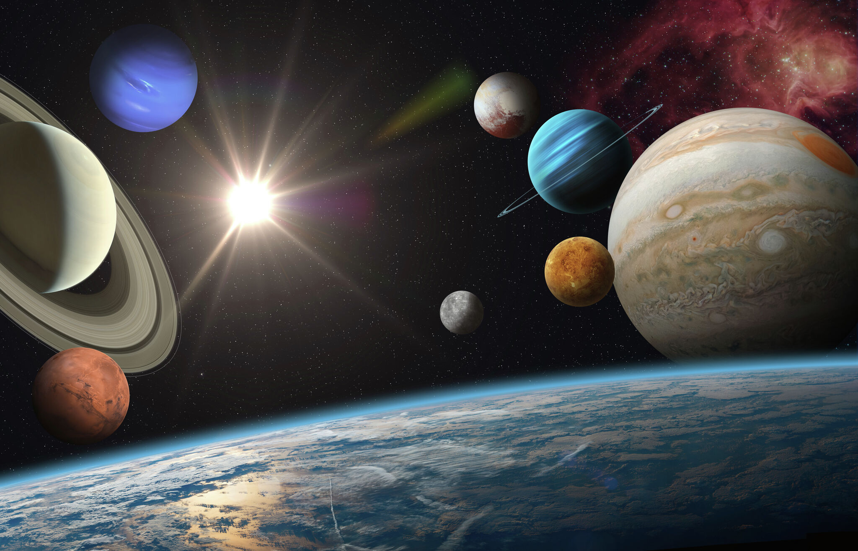
Contents
About us
Our team
Tech Stack
Implementation

Slide 3
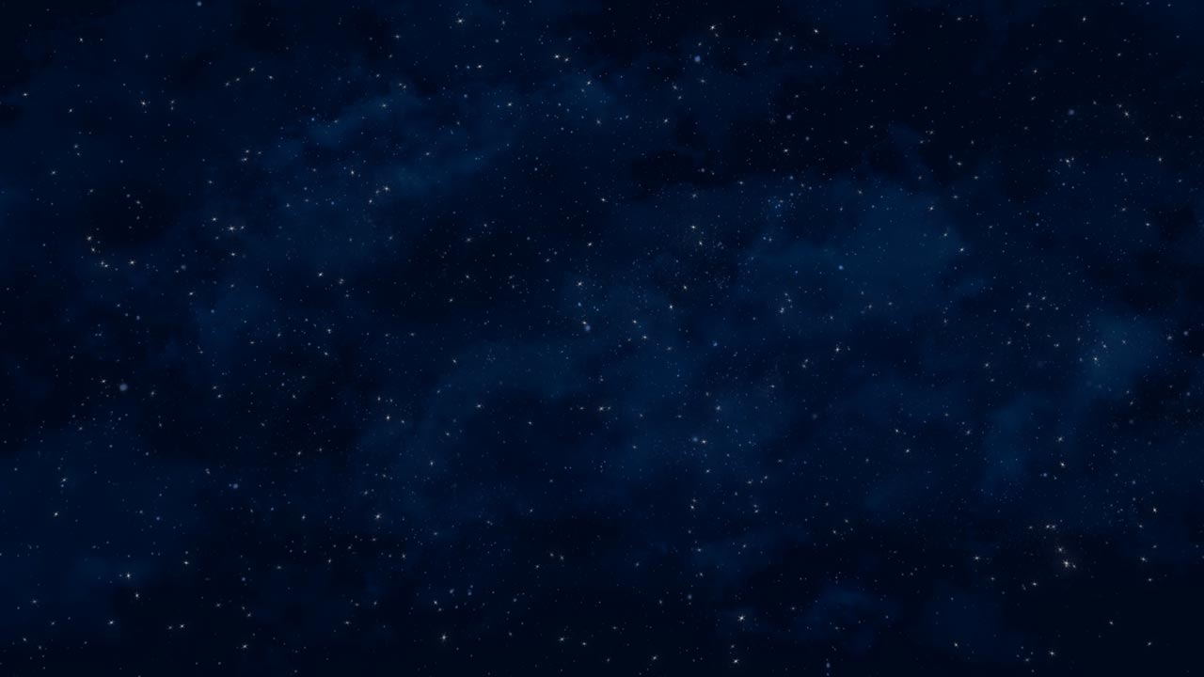
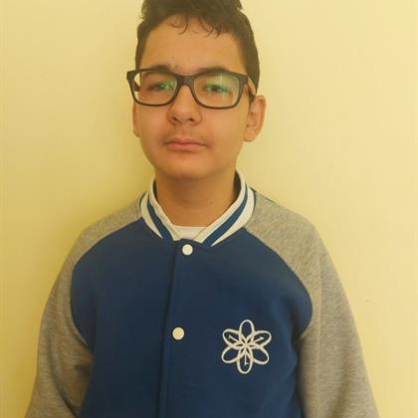
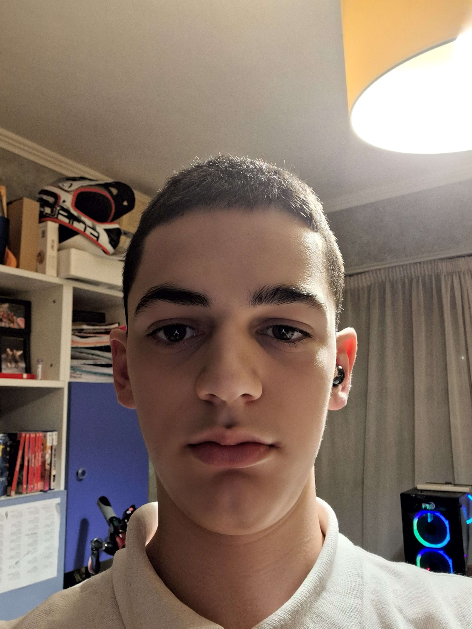
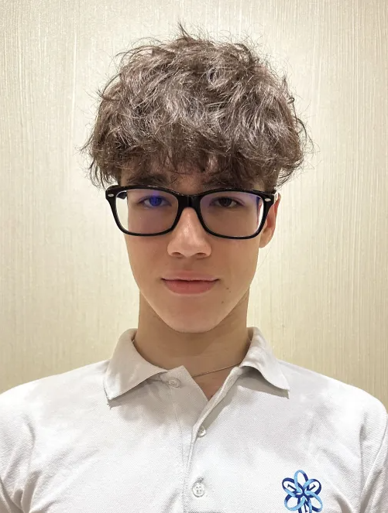
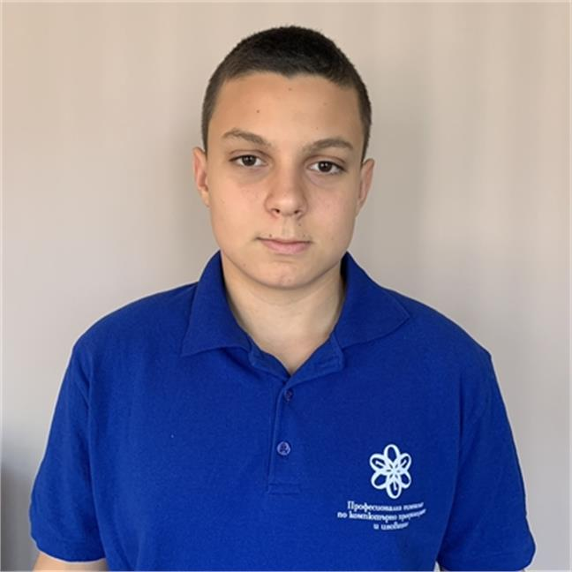
Our team
Stanislav Radev
Back-end Developer
Boris Rusinov
Back-end Developer
Alex Semerdzhiev
Back-end Developer
Milko Barev Scrum Trainer

Slide 4
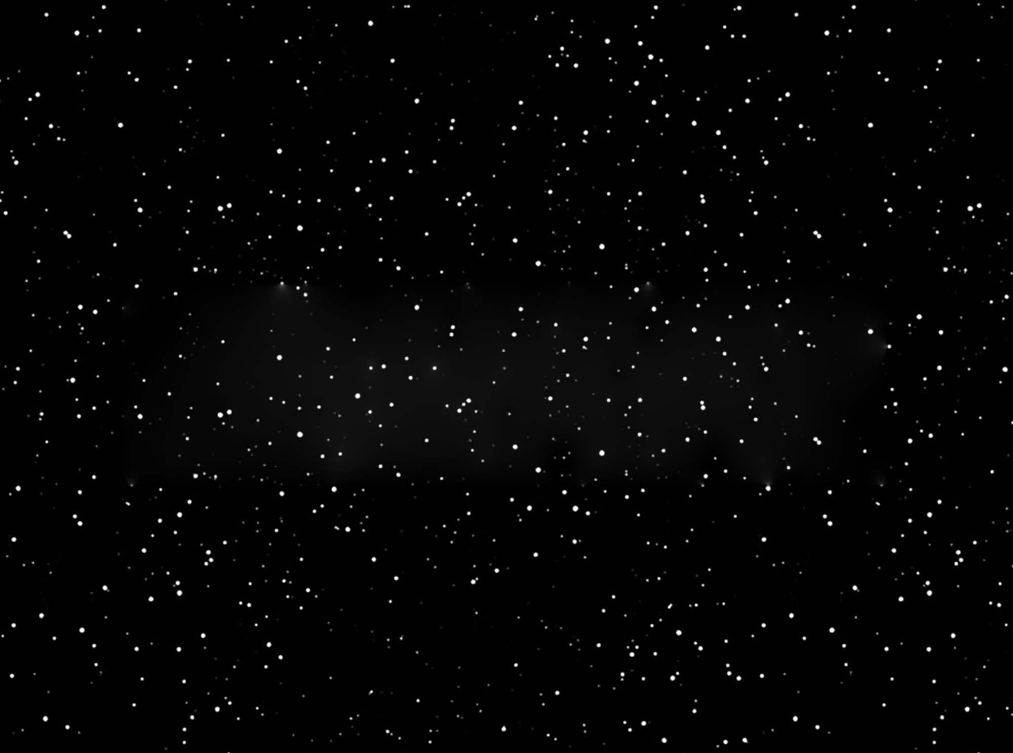
The idea
The goal of our project is to make something fun that can educate you .

Slide 5
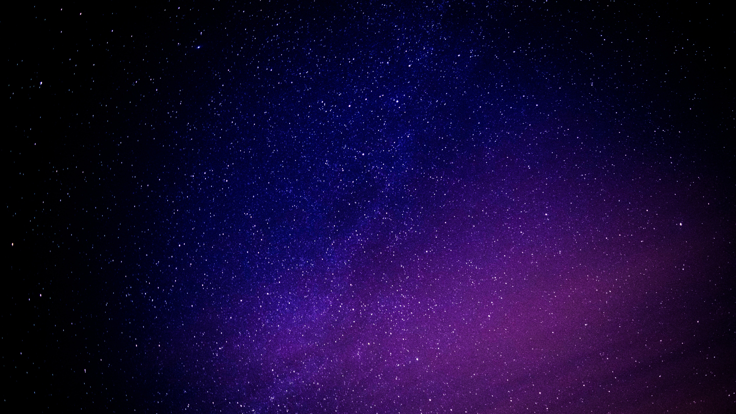






Tech Stack

Slide 6
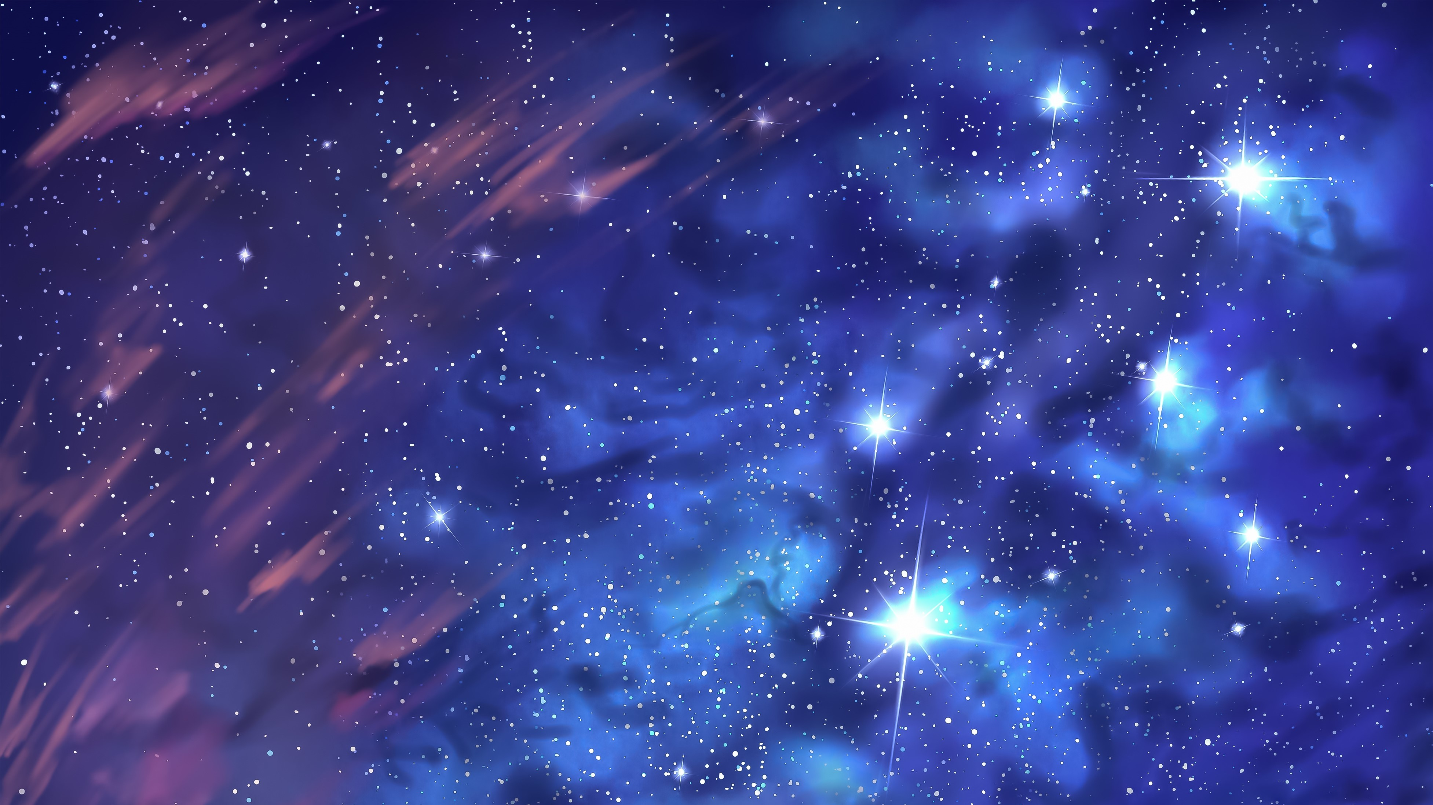
Thanks for listening!
Let’s jump to the code!

